Slide 1
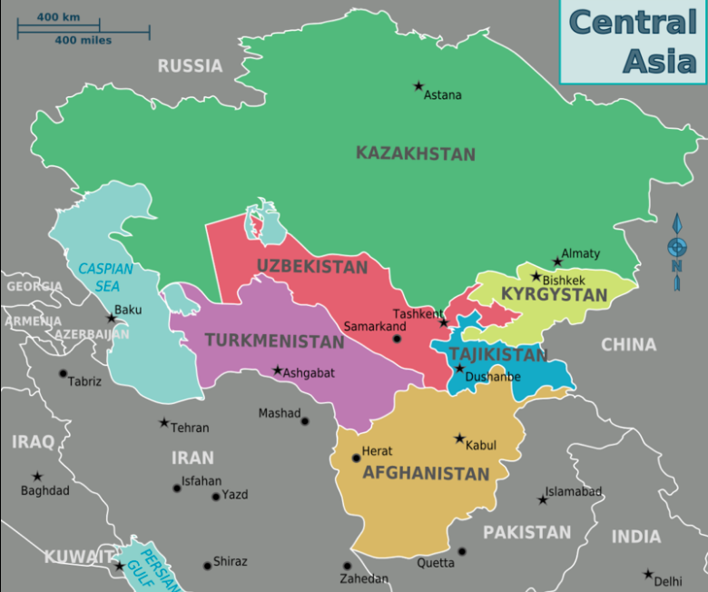
The Central Asian Republics
Language and Economy

Slide 2
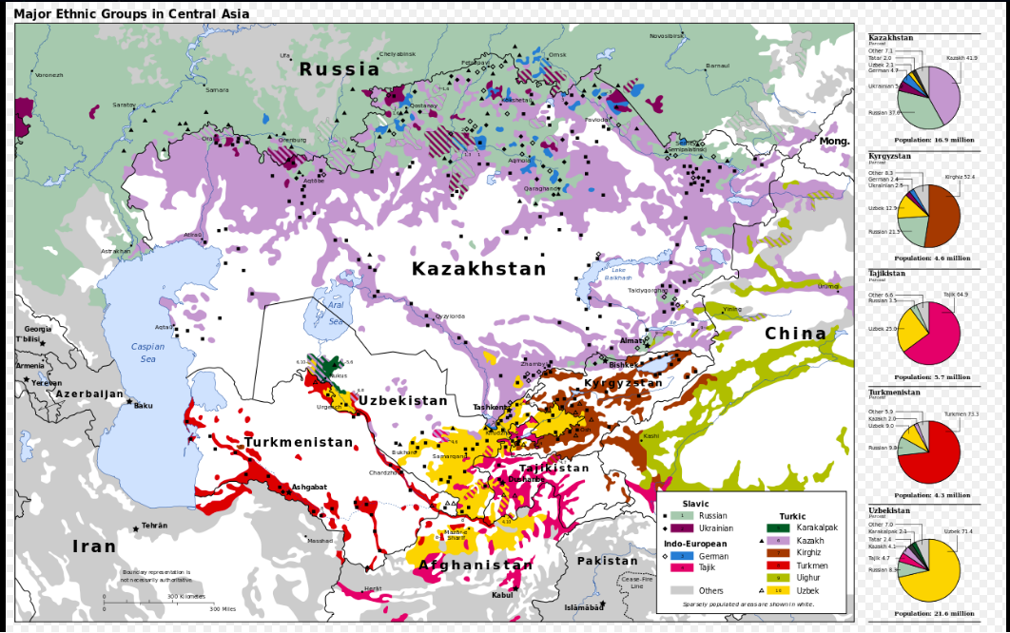
Screen Shot 2019-04-11 at 8.37.05 AM

Slide 3
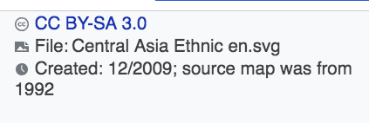
Russian Speakers Worldwide

Slide 4
Economic Data

Slide 5
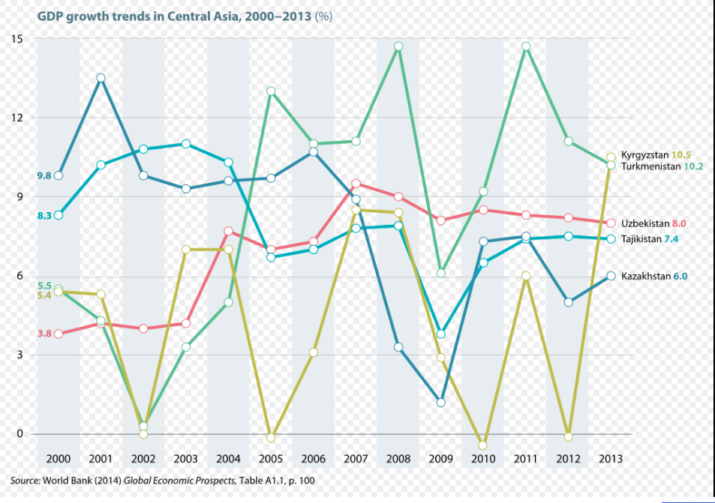

Slide 6
GDP by Sector 2005, 2013

