Slide 1
Job Description Analysis Project Deliverable 1
Joanna Russell Bliss

Slide 2
Introduction
My career goal is to work within an academic library, but there are many positions within the field.
I am currently working as a Research and User Experience Intern at Southern Methodist University, which led me to wonder…
What kinds of jobs are there in User Experience, and what do they look like? What do they require? Where are they?

Slide 3
Sources
I searched job listings on four sites:
ALA JobLIST
Digital Library Foundation (whose job board is shared with the Council on Library and Information Resources)
Indeed.com
LinkedIn

Slide 4
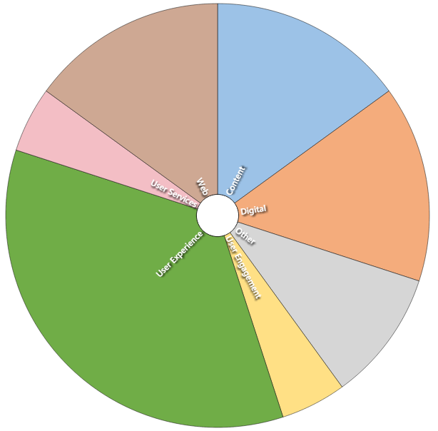
Job titles: Common terms
I was surprised to find that when I searched for “User Experience” positions, I often had to go into the 2nd or 3rd page of search results to find a “User Experience” position.
I broadened my search for related titles, and found that (like many fields), there are many related job titles.
About half of the titles I found included “User Experience” (7 instances); several also included the terms “Digital,” “Content” and “Web,” as well as “User Engagement” and “User Services.”

Slide 5
Requirement of an MLS/MLIS
All but one of the jobs requires the equivalent of an ALA-accredited MLS or MLIS.

Slide 6
Requirement of an MLS/MLIS
Perhaps this is because the listing for the User Services Librarian at Texas Tech doesn’t list a requirement for any type of degree.

Slide 7
Job responsibilities
The job responsibilities in these 15 listings could be coded into 17 different categories.

Slide 8
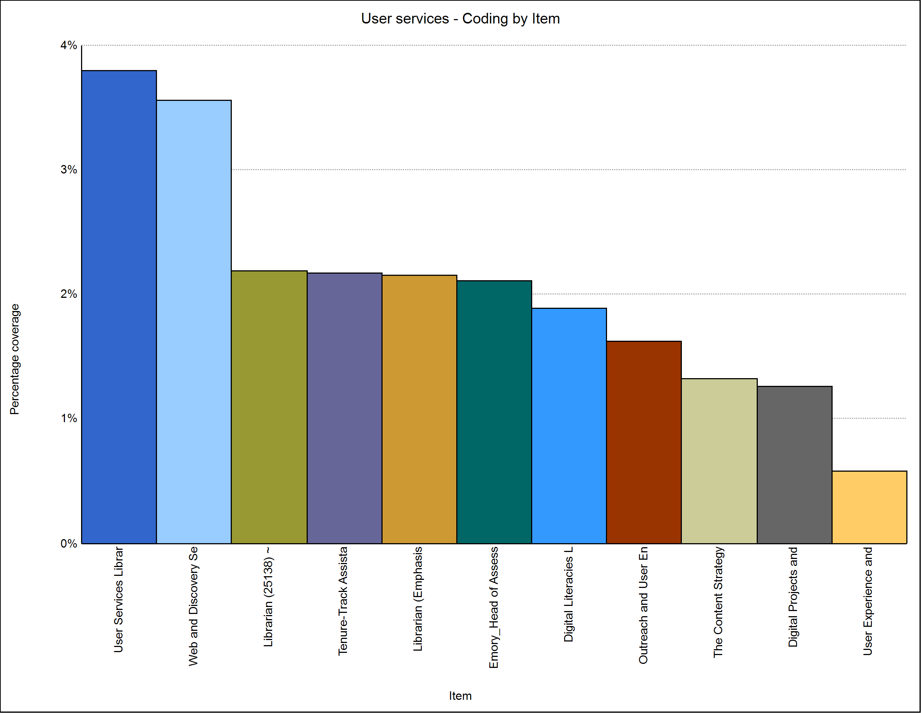
Job responsibilities
11 of the job listings had at least one responsibility that correlated to user services, with 28 different instances in the responsibilities listed for these 15 jobs.

Slide 9
Job responsibilities
The user services tasks included such responsibilities as:
“Reference and instructional services—providing in-person reference, virtual reference, individual research consultations” (Digital Literacies Librarian, 2018, Responsibilities).
“Lead a team and collaborate with colleagues to plan, develop, implement, promote, and assess library services” (Emory, Head of Assessment and User Services, n.d., Essential Responsibilities & Duties: Assessment & User Experience).
“Use skills and knowledge concerning usability to understand and improve the physical and digital library user experience” [Librarian (25138) at The California State University, 2019, Responsibilities].
“Develop enhancements to circulation, course reserves, reference, and instructional services” [Librarian (Emphasis in User Experience and Technology) at Chabot - Las Positas Community College District, 2019, Representative Duties].
“Recommends new initiatives to meet user needs regarding library resources, spaces, and services” (West Chester University: Tenure-Track Assistant Professor, Collection Strategist and User Experience Librarian, 2019, Responsibilities: Collection Strategy and User Experience).

Slide 10
Job responsibilities
Content management and creation was the 2nd most common category.
17 of the job responsibilities could be categorized under content management.
There was a wide range of skills within these responsibilities, from “author original webpage content as necessary” (Web Content and User Experience Specialist, n.d., Role of the Position) to “managing, supporting, and integrating a range of library systems including the web discovery platform” (Web and Discovery Services Librarian, 2019, General Description of the Position).
A majority of the jobs (9) required some type of campus service or involvement, but only six mentioned working with faculty to teach students on campus or to help faculty with research.
Two of the jobs, the ones at UMass Amherst and the University of Mary Washington, required some form of technical support.
The job at West Chester University was the only listing that mentioned overseeing budgets (2019, Responsibilities: Collection Strategy and User Experience).

Slide 11
Job locations
A textual analysis of the job locations showed that these positions were in a variety of states – the most found were in California (4), but the variety of states and locations shows that these jobs are available across the U.S., including Texas.
Every job listing analyzed was at an academic library housed at a university or college.

Slide 12
Salary
Only 1/3, or five, of the job listings had hard figures for salary; the rest said it was commensurate with experience, had a pay scale linked to for the university, or didn’t list anything at all.
The lowest listed starting salary was for the Web Content and User Specialist position at UNLV, at $52,000 (2019, Salary Range).
All of the other listed starting salaries were within $13,000 of that [Librarian (Emphasis in User Experience and Technology) at Chabot - Las Positas Community College District, 2019, Pay Rate (or Annual Salary); Student Success Librarian at University of Florida, George A. Smathers Libraries, 2019, Salary Info; User Experience and Web Services Librarian at University of Massachusetts-Amherst, 2019, Additional Information].
And the highest starting salary was at UC Berkeley, at $65,942 (Digital Literacies Librarian at University of California-Berkeley, 2018, Hiring Range).
The starting salaries are all within the range of $50,000-$65,000, but given the small sample selection and the geographic spread of these positions, I would need to do more research to discern what an entry level job in Texas might pay.

Slide 13
Themes across job descriptions

Slide 14
Themes across job descriptions
User services is a key component of these jobs.
Given the job titles I looked for, this isn’t completely surprising.
Some form of “user” (user, users, users’) appeared more than 100 times in these listings, with “services” following close behind with 89 instances.
The word “student” or “students” was also used heavily in these listings, appearing 60 times.
I will be expected to be a part of a team.
Forms of the words “collaborate,” “community,” and “team” were all used frequently in these listings, appearing 40, 39, and 21 times respectively.
I should be prepared to think creatively and to not only be aware of trends within the profession, but to be on the cutting edge.
Librarians in academic libraries are often expected to do research (54 appearances) and scholarship (12), as well as to be innovative (18) and creative (11).

Slide 15
Conclusion
There are a great variety of job titles and listings that encompass user experience at the academic level.
I should be prepared to improve my technical skills related to managing website content, and to become familiar with database construction and management, but these jobs also require a personal touch, working with students and faculty to facilitate research, improving information literacy, and creating programming to engage students, teachers and staff on campus.

Slide 16
References: Job listings
The Content Strategy Librarian at University of North Carolina at Chapel Hill. (2019, September 5). (Indeed.com website.) Retrieved from https://www.indeed.com/viewjob?jk=15cd0de57e7208f3&tk=1dl7is9j3p6ok803&from=serp&vjs=3.
Digital Content Management Librarian at Harvard Graduate School of Education. (2019, March 29). (CLIR + DLF Job Board website.) Retrieved from https://jobs.diglib.org/job/digital-content-management-librarian/.
Digital Literacies Librarian at University of California-Berkeley. (2018, December 12). (CLIR + DLF Job Board website.) Retrieved from https://jobs.diglib.org/job/digital-literacies-librarian/.
Digital Projects and User Experience Librarian (Part-Time) at Saint Leo University. (n.d.). (Indeed.com website.) Retrieved from https://www.indeed.com/viewjob?jk=05674f22d54468a4&tk=1dl7i7ll3p6ok802&from=serp&vjs=3.

Slide 17
References: Job listings
Head, Assessment and User Experience. (n.d.). (Emory Libraries & Information Technology website at Emory University.) Retrieved from http://web.library.emory.edu/documents/pa_Head%20of%20Assessment%20and%20User%20Services.pdf.
Librarian (25138) at The California State University. (2019, September 15). (LinkedIn.com website.) Retrieved from https://www.linkedin.com/jobs/view/1502378846/.
Librarian (Emphasis in User Experience and Technology)at Chabot - Las Positas Community College District. (2019, September 9). Retrieved from https://www.indeed.com/viewjob?jk=27c9c7be8ae9f168&tk=1dl7i1gqtp6ok802&from=serp&vjs=3.
San Jose State University: Outreach and User Engagement Librarian. (2019, August 30). (ALA JobLIST website.) Retrieved from https://joblist.ala.org/job/outreach-and-user-engagement-librarian/50410055/.

Slide 18
References: Job listings
Student Success Librarian at University of Florida, George A. Smathers Libraries. (2019, June 12). (CLIR + DLF Job Board website.) Retrieved from https://jobs.diglib.org/job/student-success-librarian/.
User Experience Analyst at NYU, Division of Libraries. (2019, March 14). (CLIR + DLF Job Board website.) Retrieved from https://jobs.diglib.org/job/user-experience-analyst/.
User Experience and Web Services Librarian at University of Massachusetts-Amherst. (2019, June 26). (Indeed.com website.) Retrieved from https://www.indeed.com/viewjob?jk=2d63dabc7bf49b48&tk=1dl7i1gqtp6ok802&from=serp&vjs=3.
User Services Librarian at Texas Tech University School of Law Library. (2019, September 18), (Indeed.com website.) Retrieved from https://www.indeed.com/viewjob?jk=8d4791c654e04e12&tk=1dl883r1bpbcg803&from=serp&vjs=3.

Slide 19
References: Job listings
Web Content and User Experience Specialist, UNLV University Libraries at University of Nevada, Las Vegas. (n.d.) (Indeed.com website.) Retrieved from https://www.indeed.com/viewjob?jk=9056aa58e0037c2f&tk=1dl7i5juep6ok803&from=serp&vjs=3.
Web and Discovery Services Librarian at University of Mary Washington. (2019, September 19), (LinkedIn.com website.) Retrieved from https://www.linkedin.com/jobs/view/1448160673/.
West Chester University: Tenure-Track Assistant Professor, Collection Strategist and User Experience Librarian. (2019, September 10). (ALA JobLIST website.) Retrieved from https://joblist.ala.org/job/tenure-track-assistant-professor-collection-strategist-and-user-experience-librarian/50588475/.

