Slide 1
Intro to Political Culture
And the UK Example

Slide 2
Defining Political Culture?
Sometimes called a ”soft” variable
What are it’s component parts?
  Values
  Attitudes
  Beliefs
  Behaviors
  Traditions

Slide 3
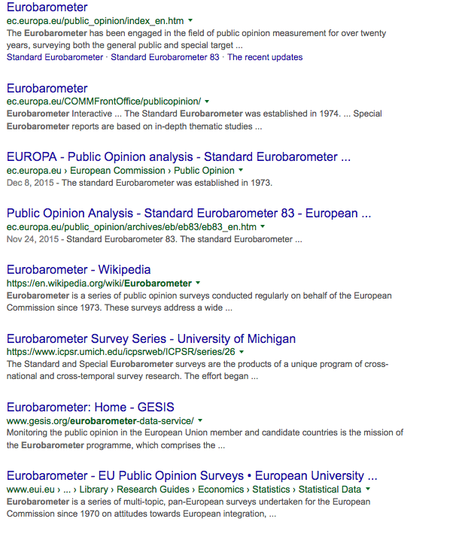
Measuring Political Culture
If we were to try to “measure it” how would we do it?
  Historical accounts, ”thick description”
  Attitudinal data; survey research
Places to look
  World Values Survey
  Eurobarometer
    Available several places

Slide 4
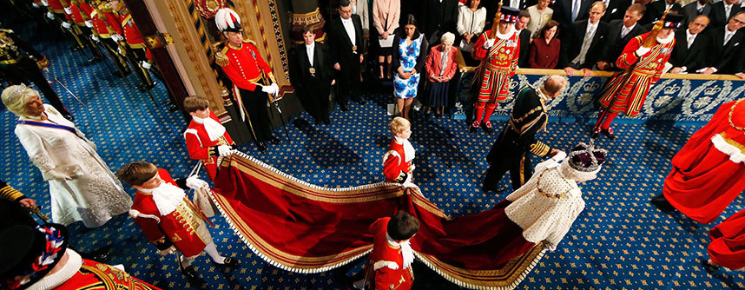
Political Culture of the UK
Values, Attitudes, Beliefs, Behaviors, Traditions (click photo)

Slide 5
Attributes of British Political Culture
Deference to authority
Value continuity, tradition
  BUT ALSO PRAGMATIC, WILLING TO CHANGE WITH TIMES
CONSTITUTIONALISM
  UNWRITTEN CONSTITUTION
  SEVERAL COMPONENT PARTS
  Monarchism

Slide 6
Attributes of British Political Culture
Regional ‘national’ identities
Empire?
Diversity, amalgamation, multiculturalism
Isolationism?
Anglo-Americanism
  The special relationship

