Slide 1
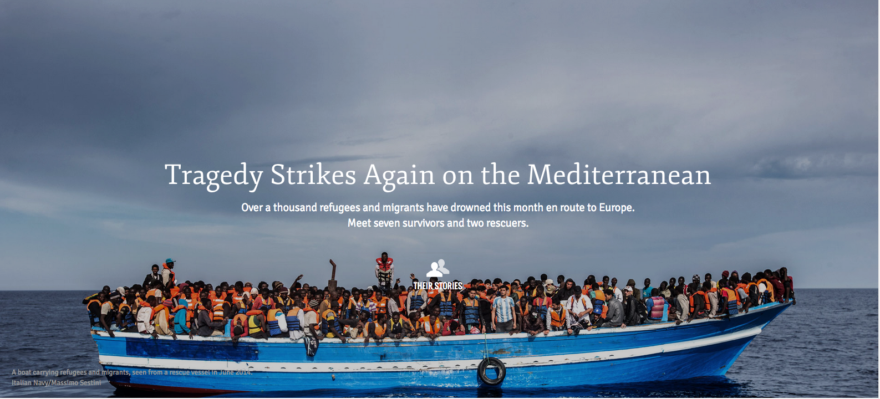
Europe’s Refugee Crisis 2007-2016
Based on data from United Nations High Commission for Refugees 2015 as presented in Wikipedia entry “List of Countries by Refugee Population,” accessed September 21, 2016

Slide 2
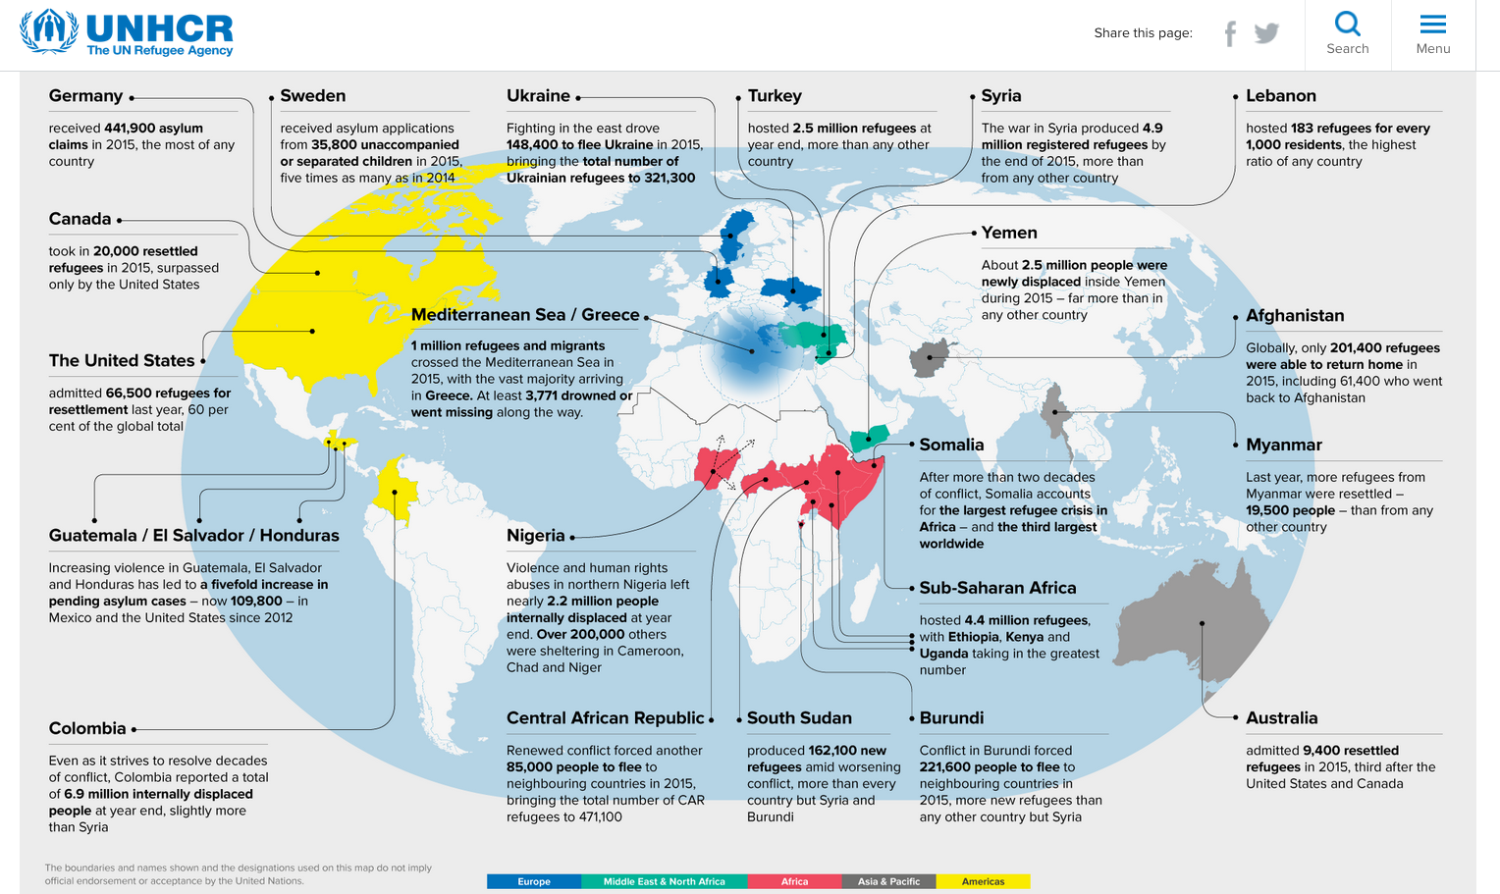
2015: Record Year for
Global Refugee Displacement

Slide 4
EU28 with Comparison Countries
Number of Refugees Received 2007-mid2015

Slide 5
Top European Countries Accepting
UNHCR Registered Refugees
2007-mid2015

Slide 6
Number of Refugee per thousand residents
EU15+Norway and Switzerland

Slide 7
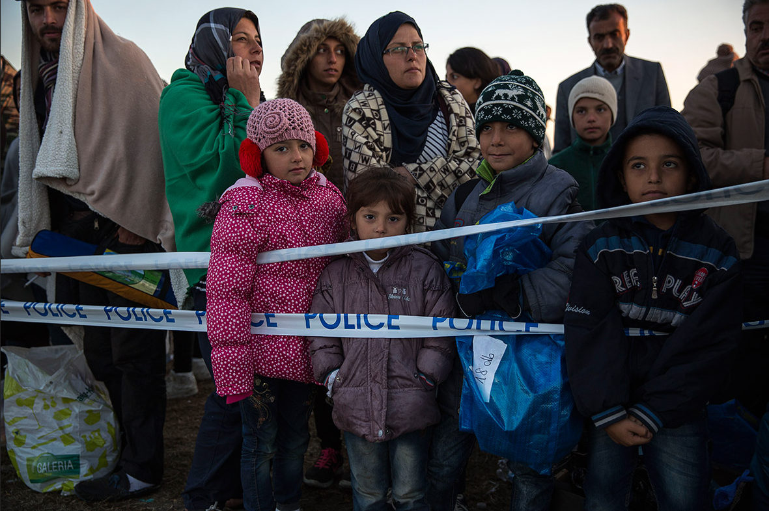
More on the Refugee Crisis
Nolager.org: NGO opposes camps for migrants and refugees
EU Commmissioner for Migration blasts EU for inaction
President Obama Stresses Need to Address Refugee Crisis at last UN Speech
NATO Command Claims Russia is Using Refugee Crisis as a Weapon against Europe
HRW: Russia not doing fair share for Syrian refugees
Amnesty Int’l: China most, Russia least welcoming to refugees

